Slide 1
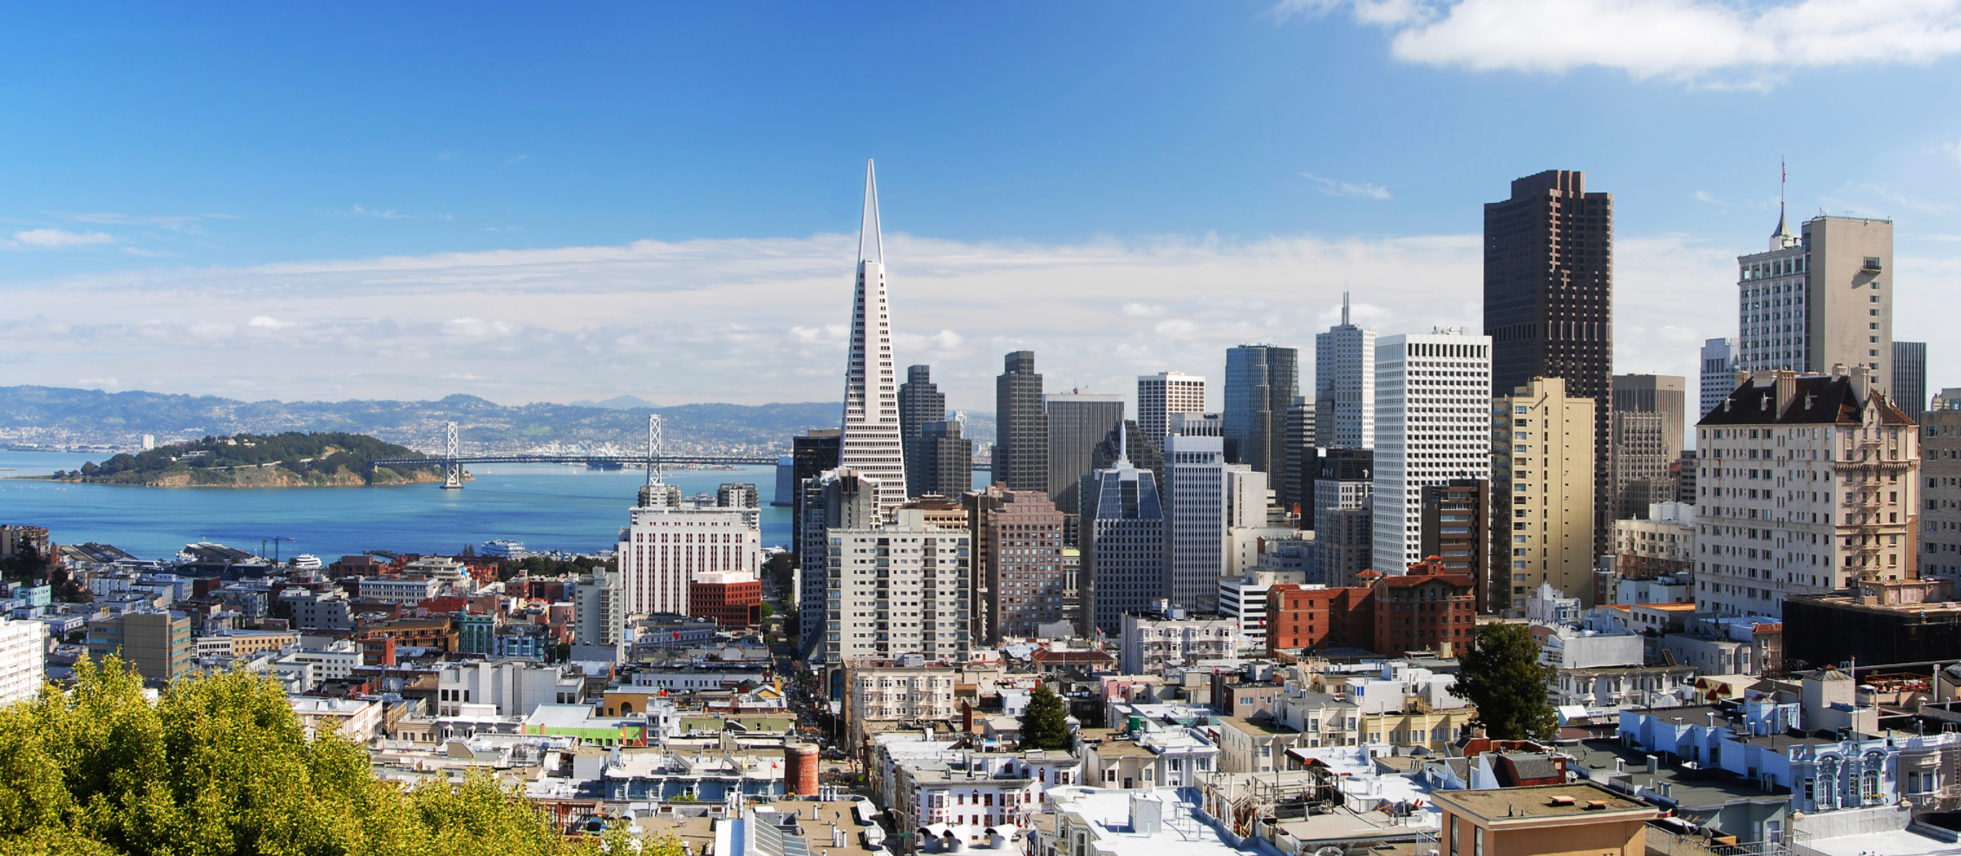
Homelessness in San Francisco

Slide 2
Population growth in San Francisco

Slide 3
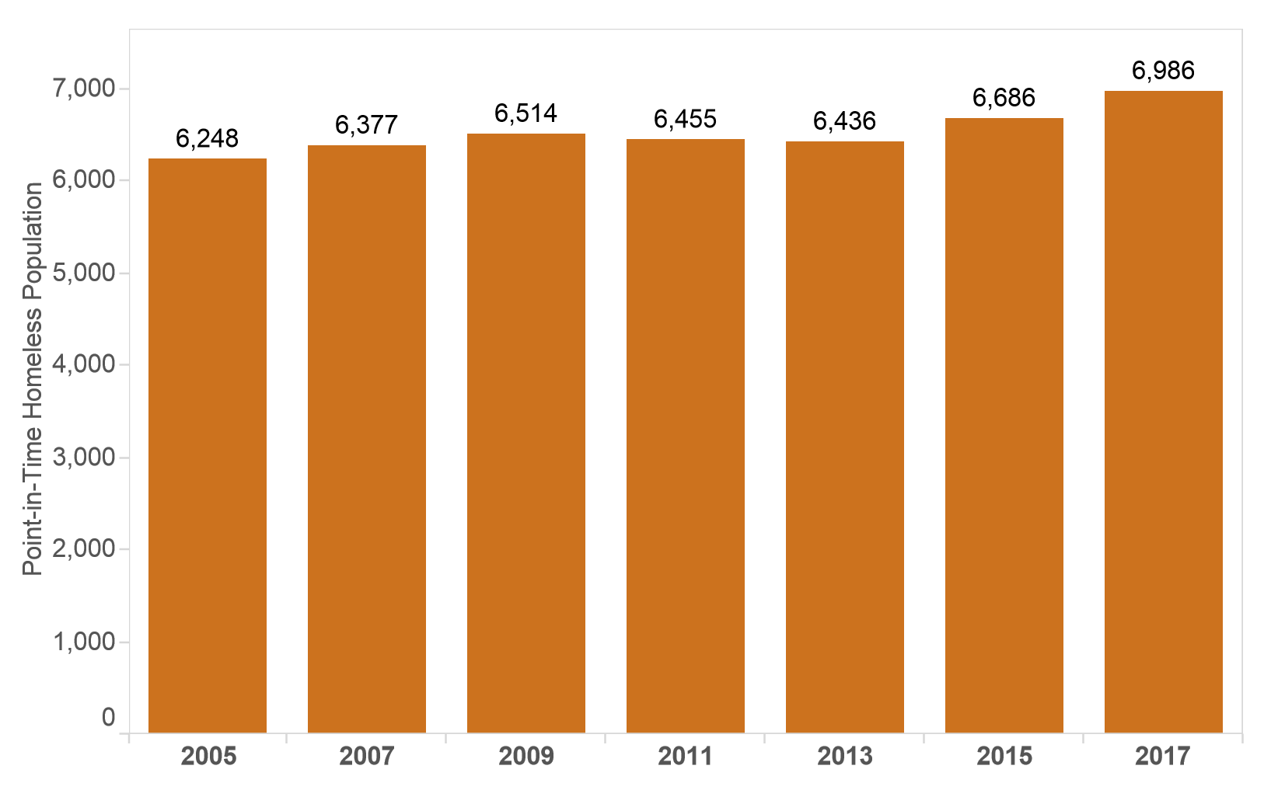
Homeless Population in San Francisco

Slide 5
The Project

Slide 6
Genre
Animation
Annotated charts

Slide 7
Data
311 cases in San Fransisco from 2008 until today
Initially
2.87 million rows, 964,6 MB and 19 columns
After removing irrelevant data
~145.000 rows, 147 MB, 5 columns
Link
https://data.sfgov.org/City-Infrastructure/311-Cases/vw6y-z8j6
Annotated charts

